Slide 1
Computed Tomography I
Basic principles
Geometry and historical development

Slide 2
Basic principles
Mathematical principles of CT were first developed in 1917 by Radon
Proved that an image of an unknown object could be produced if one had an infinite number of projections through the object

Slide 3
Basic principles (cont.)
Plain film imaging reduces the 3D patient anatomy to a 2D projection image
Density at a given point on an image represents the x-ray attenuation properties within the patient along a line between the x-ray focal spot and the point on the detector corresponding to the point on the image

Slide 4
Basic principles (cont.)
With a conventional radiograph, information with respect to the dimension parallel to the x-ray beam is lost
Limitation can be overcome, to some degree, by acquiring two images at an angle of 90 degrees to one another
For objects that can be identified in both images, the two films provide location information

Slide 5
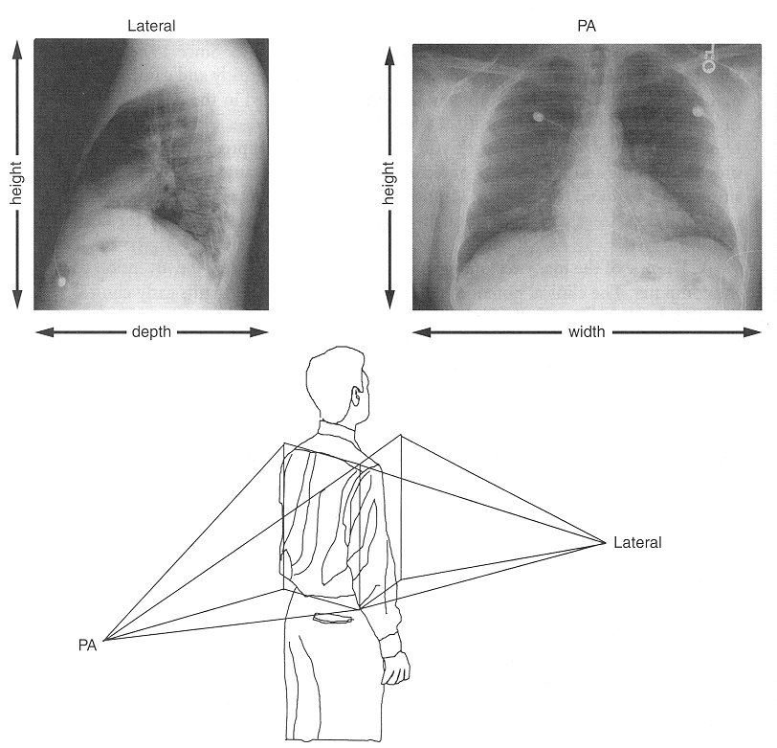

Slide 6
Tomographic images
The tomographic image is a picture of a slab of the patient’s anatomy
The 2D CT image corresponds to a 3D section of the patient
CT slice thickness is very thin (1 to 10 mm) and is approximately uniform
The 2D array of pixels in the CT image corresponds to an equal number of 3D voxels (volume elements) in the patient
Each pixel on the CT image displays the average x-ray attenuation properties of the tissue in the corrsponding voxel

Slide 7
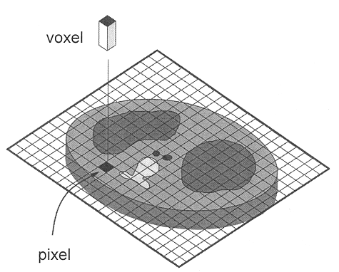

Slide 8
Tomographic acquisition
Single transmission measurement through the patient made by a single detector at a given moment in time is called a ray
A series of rays that pass through the patient at the same orientation is called a projection or view
Two projection geometries have been used in CT imaging:
  Parallel beam geometry with all rays in a projection parallel to one another
  Fan beam geometry, in which the rays at a given projection angle diverge

Slide 9
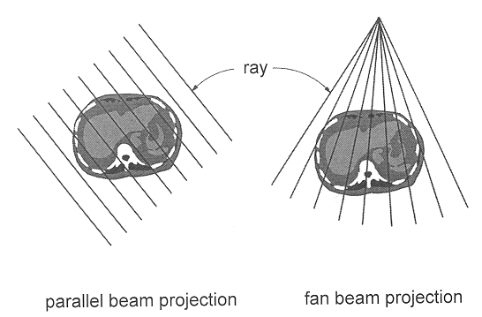

Slide 10
Acquisition (cont.)
Purpose of CT scanner hardware is to acquire a large number of transmission measurements through the patient at different positions
Single CT image may involve approximately 800 rays taken at 1,000 different projection angles
Before the acquisition of the next slice, the table that the patient lies on is moved slightly in the cranial-caudal direction (the “z-axis” of the scanner)

Slide 11
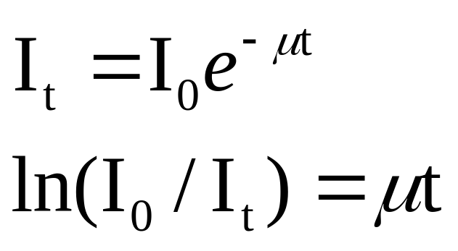
Tomographic reconstruction
Each ray acquired in CT is a transmission measurement through the patient along a line
The unattenuated intensity of the x-ray beam is also measured during the scan by a reference detector

Slide 12
Reconstruction (cont.)
There are numerous reconstruction algorithms
Filtered backprojection reconstruction is most widely used in clinical CT scanners
Builds up the CT image by essentially reversing the acquistion steps
The μ value for each ray is smeared along this same path in the image of the patient
As data from a large number of rays are backprojected onto the image matrix, areas of high attenutation tend to reinforce one another, as do areas of low attenuation, building up the image

Slide 13
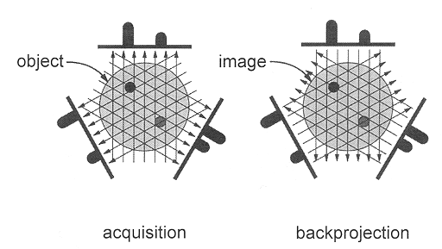

Slide 14
1st generation: rotate/translate, pencil beam
Only 2 x-ray detectors used (two different slices)
Parallel ray geometry
Translated linearly to acquire 160 rays across a 24 cm FOV
Rotated slightly between translations to acquire 180 projections at 1-degree intervals
About 4.5 minutes/scan with 1.5 minutes to reconstruct slice

Slide 15
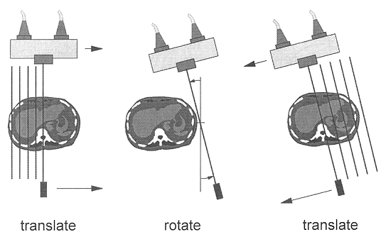

Slide 16
1st generation (cont.)
Large change in signal due to increased x-ray flux outside of head
  Solved by pressing patient’s head into a flexible membrane surrounded by a water bath
NaI detector signal decayed slowly, affecting measurements made temporally too close together
Pencil beam geometry allowed very efficient scatter reduction, best of all scanner generations

Slide 17
2nd generation: rotate/translate, narrow fan beam
Incorporated linear array of 30 detectors
More data acquired to improve image quality (600 rays x 540 views)
Shortest scan time was 18 seconds/slice
Narrow fan beam allows more scattered radiation to be detected

Slide 18
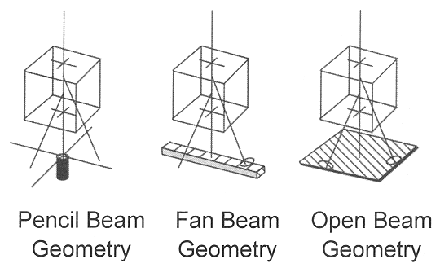

Slide 19
3rd generation: rotate/rotate, wide fan beam
Number of detectors increased substantially (to more than 800 detectors)
Angle of fan beam increased to cover entire patient
  Eliminated need for translational motion
Mechanically joined x-ray tube and detector array rotate together
Newer systems have scan times of ½ second

Slide 20
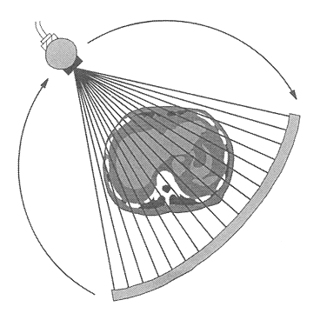

Slide 21
Ring artifacts
The rotate/rotate geometry of 3rd generation scanners leads to a situation in which each detector is responsible for the data corresponding to a ring in the image
Drift in the signal levels of the detectors over time affects the μt values that are backprojected to produce the CT image, causing ring artifacts

Slide 22
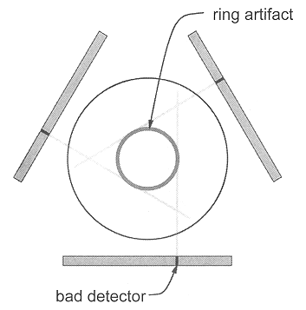

Slide 23
4th generation: rotate/stationary
Designed to overcome the problem of ring artifacts
Stationary ring of about 4,800 detectors

Slide 24
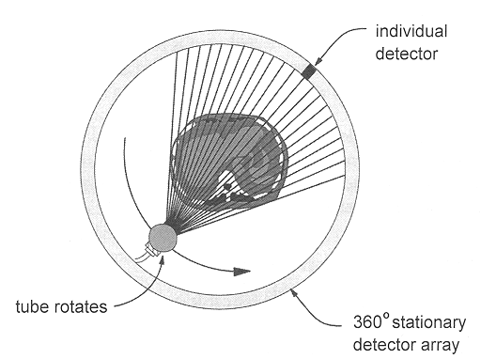

Slide 25
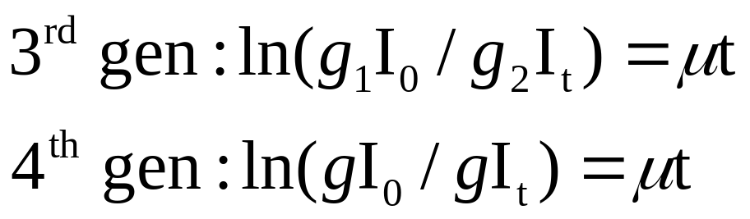
3rd vs. 4th generation
3rd generation fan beam geometry has the x-ray tube as the apex of the fan; 4th generation has the individual detector as the apex

Slide 26
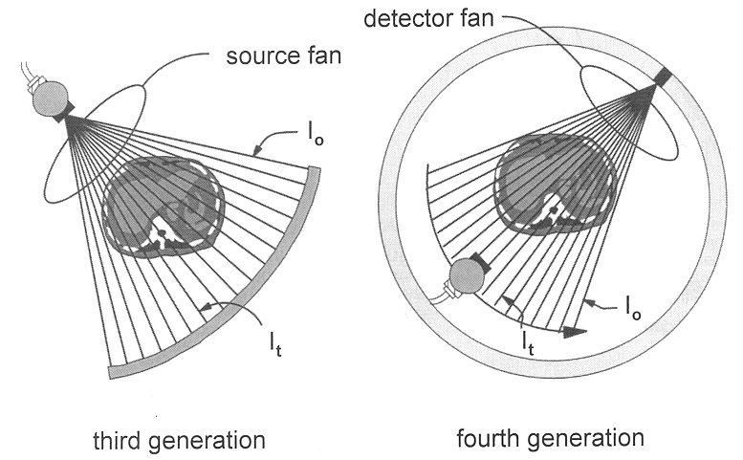

Slide 27
5th generation: stationary/stationary
Developed specifically for cardiac tomographic imaging
No conventional x-ray tube; large arc of tungsten encircles patient and lies directly opposite to the detector ring
Electron beam steered around the patient to strike the annular tungsten target
Capable of 50-msec scan times; can produce fast-frame-rate CT movies of the beating heart

Slide 28
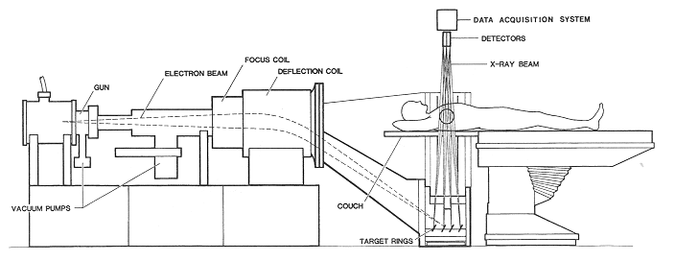

Slide 29
6th generation: helical
Helical CT scanners acquire data while the table is moving
By avoiding the time required to translate the patient table, the total scan time required to image the patient can be much shorter
Allows the use of less contrast agent and increases patient throughput
In some instances the entire scan be done within a single breath-hold of the patient

Slide 30
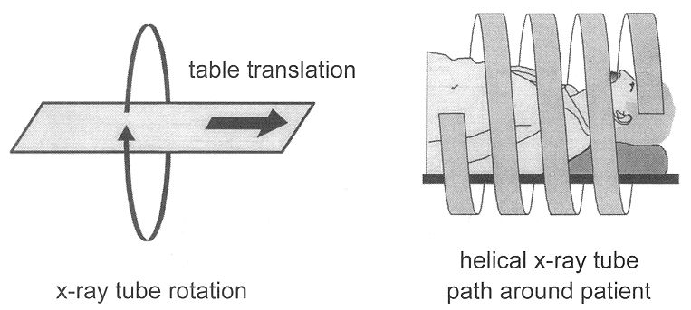

Slide 31
7th generation: multiple detector array
When using multiple detector arrays, the collimator spacing is wider and more of the x-rays that are produced by the tube are used in producing image data
  Opening up the collimator in a single array scanner increases the slice thickness, reducing spatial resolution in the slice thickness dimension
  With multiple detector array scanners, slice thickness is determined by detector size, not by the collimator

Slide 32
